Slide 1
Equivalence Relations
Fall 2023

Slide 2
Overview and Due
Topics:
Equivalence classes
Schedule notes:
Non sequitur lesson on Friday -- induction
Due
HW 18a and 18b due Wednesday (What if you did 18b before…)
HW 19 and 20 due Friday
Project 4 due Nov 30 (Hackathon Nov 27)
Start project 4 early. It usually takes a bit longer
help sessions this week
my “project 4 journal” has been posted under project 4

Slide 3
Big Picture
Relations
Binary Relations
Relations on a Set
Equivalence Relations
An equivalence relation “acts” like “equal to”
Reflexive
Symmetric
Transitive
Finally, the last circle

Slide 4
Definition
A relation is called an equivalence relation if it is reflexive, symmetric, and transitive
Def 1 section 9.5.2
Think of an equivalence relation as a generalization of “is equal to”

Slide 5
Definition
A relation is called an equivalence relation if it is reflexive, symmetric, and transitive
Def 1 section 9.5.2
Consider R “is equal to” and the set A = {1,2,3,4}
reflexive?
symmetric?
transitive?

Slide 6
Definition
A relation is called an equivalence relation if it is reflexive, symmetric, and transitive
Def 1 section 9.5.2
Infix notation: aRb, a=b
Consider R “is equal to” and the set A = {1,2,3,4}
reflexive?
symmetric?
transitive?

Slide 7
Example from AI Robotics

Slide 8
1
1
2
G
A
3
C
B
4
5
6
D
D
R

Slide 9
1
1
2
G
A
3
C
B
4
5
6
D
D
R
R = PassesBetweenSameBuildings(j,k)

Slide 10
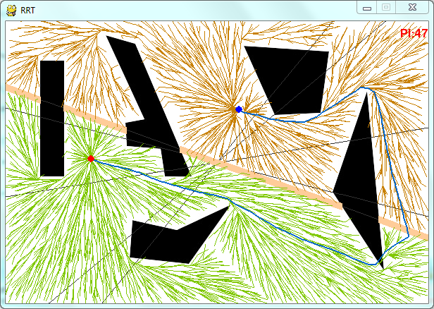
All paths in the same homotopy class are equivalent

Slide 11
Finding the fastest path in the equivalence class

Slide 12
1
1
2
G
A
3
C
B
1
2
3
4
5
6
D
4
5
D
6
R
R = PassesBetweenSameBuildings(j,k)

Slide 13
1
1
2
G
A
3
C
B
1
2
3
4
Reflexive?
5
6
D
4
5
D
6
R
R = PassesBetweenSameBuildings(j,k)

Slide 14
1
1
2
G
A
3
C
B
1
2
3
4
Reflexive? 😀
Symmetric?
5
6
D
4
5
D
6
R
R = PassesBetweenSameBuildings(j,k)

Slide 15
1
1
2
G
A
3
C
B
1
2
3
4
Reflexive? 😀
Symmetric? 😀
Transitive?
5
6
D
4
5
D
6
R
R = PassesBetweenSameBuildings(j,k)

Slide 16
1
1
A matrix test for transitivity:
M_{R} = M_{R} ∨ M_{R}^{[2]}
2
G
A
3
C
B
1
2
3
4
Reflexive? 😀
Symmetric? 😀
Transitive?
5
6
D
4
5
D
6
R
R = PassesBetweenSameBuildings(j,k)

Slide 17
1
1
A matrix test for transitivity:
M_{R} = M_{R} ∨ M_{R}^{[2]}
2
G
A
3
C
B
1
2
3
4
Reflexive? 😀
Symmetric? 😀
Transitive? 😀
5
6
D
4
5
D
6
R
R = PassesBetweenSameBuildings(j,k)

Slide 18
Practice

Slide 19
Practice: Is R an Equivalence Relation?

Slide 20
Practice: Is R an Equivalence Relation?
1
2
3
4
5
6

Slide 21
Practice: Is R an Equivalence Relation?
Reflexive? 😀
Symmetric?
Transitive?
1
2
3
4
5
6

Slide 22
Practice: Is R an Equivalence Relation?
Reflexive? 😀
Symmetric? 😀
Transitive?
1
2
3
4
5
6

Slide 23
Practice: Is R an Equivalence Relation?
Reflexive? 😀
Symmetric? 😀
Transitive? 😀
1
2
3
4
5
6

Slide 24
Equivalence Classes are Common so they have their own Notation and Terminology

Slide 25
Terminology
Equivalent elements
Equivalence class
Set of equivalent elements
Graph test
Equivalence class representation
Partition

Slide 26
Equivalent elements
Given a relation R, two elements a and b (of set A) are equivalent if
R is an equivalence relation, AND
aRb, R(a,b), (a,b) ∈ R

Slide 27
Equivalent elements
Given a relation R, two elements a and b (of set A) are equivalent if
R is an equivalence relation, AND
aRb, R(a,b), (a,b) ∈ R
When a and b are equivalent, we write

Slide 28
Equivalent elements
Given a relation R, two elements a and b (of set A) are equivalent if
R is an equivalence relation, AND
aRb, R(a,b), (a,b) ∈ R
When a and b are equivalent, we write

Slide 29
1
1
2
G
A
3
C
B
Which paths are equivalent?
1
2
3
4
5
6
D
4
5
D
6
R
R = PassesBetweenSameBuildings(j,k)

Slide 30
1
1
2
G
A
3
C
B
1
2
3
4
5
6
D
4
5
D
6
R
R = PassesBetweenSameBuildings(j,k)

Slide 31
Equivalence class
We can group equivalent elements of A together
Suppose R is an equivalence relation on A
The set of all elements of A that are related to a specific element a of A is called the equivalence class of a
Def 3 section 9.5.3

Slide 32
Equivalence class
Suppose R is an equivalence relation on A
The set of all elements of A that are related to a specific element a of A is called the equivalence class of a
We write the equivalence class of a with respect to R as

Slide 33

Equivalence class
Suppose R is an equivalence relation on A
The set of all elements of A that are related to a specific element a of A is called the equivalence class of a
We write the equivalence class of a with respect to R as
InSameGraduatingClass(a,b)
Notes:
Mnemonic: the brackets make me think of a representative of the group with arms bracketing their friends

Slide 34
Equivalence class
Suppose R is an equivalence relation on A
The set of all elements of A that are related to a specific element a of A is called the equivalence class of a
We write the equivalence class of a with respect to R as

Slide 35
1
1
2
G
A
3
C
B
1
2
3
4
5
6
D
4
5
D
6
R
R = PassesBetweenSameBuildings(j,k)

Slide 36
Graph test for equivalence
If R is an equivalence relation and M_{R} is its matrix representation
Then each connected component is an equivalence class
1
2
3
1
2
3
4
5
4
5
6
6
R

Slide 37
Representative
There is nothing special about which element of an equivalence class we choose to represent the class

Slide 38
Representative
There is nothing special about which element of an equivalence class we choose to represent the class
InSameGraduatingClass(a,b)

Slide 39
Practice: What are the Equivalence Classes?

Slide 40
Practice: Is R an Equivalence Relation?
1
2
3
4
5
6

Slide 41
Practice: What are the Equivalence Classes?

Slide 42
Partition
A partition of a set S is a collection of subsets A_{i} of S such that

Slide 43
Partition
A partition of a set S is a collection of subsets A_{i} of S such that
Definition is hidden in the middle of page 644

Slide 44
Partition
A partition of a set S is a collection of subsets A_{i} of S such that
Subsets don’t overlap
Subsets aren’t empty
S is made up of subsets

Slide 45
Partition
S
A₁
A₃
A₂
A₄
A partition of a set S is a collection of subsets A_{i} of S such that
Subsets don’t overlap
Subsets aren’t empty
S is made up of subsets

Slide 46
Partition
S
A₁
A₃
A₂
A₄
A partition of a set S is a collection of subsets A_{i} of S such that
Subsets don’t overlap
Subsets aren’t empty
S is made up of subsets

Slide 47
Partition
S
Seniors
Sophomores
Juniors
Freshmen
A partition of a set S is a collection of subsets A_{i} of S such that
Subsets don’t overlap
Subsets aren’t empty
S is made up of subsets

Slide 48
A Theorem

Slide 49
The Equivalence Classes Partition A
Subsets don’t overlap
Subsets aren’t empty
S is made up of subsets

Slide 50
1
1
2
G
A
3
C
B
4
5
6
D
D
R
R = PassesBetweenSameBuildings(j,k)

Slide 51
The Equivalence Classes Partition A
Subsets don’t overlap
Subsets aren’t empty
A is made up of subsets

Slide 52
The Equivalence Classes Partition A
Subsets don’t overlap
Subsets aren’t empty
A is made up of subsets

Slide 53
The Equivalence Classes Partition A
Subsets don’t overlap
Subsets aren’t empty
A is made up of subsets

Slide 54
An Application To Testing
Thanks Brett Decker!

Slide 55
Trigger warning – I’ll be talking about suicide
If you need to leave, nobody will judge.

Slide 56
Equivalence Partitioning Test Case Design
A = program inputs
ages of people in a healthcare system database
R = in same age range as
Form equivalence classes of age groups
Use suicide rate from 2011-2022
Notes:
I googled “equivalence partitioning test case design”. The information from this slide is from https://www.softwaretestingmaterial.com/equivalence-partitioning-testing-technique/
If I had found a different site more easily, I would have used that one. Way too many adds on the site I used.
The example is my own

Slide 57
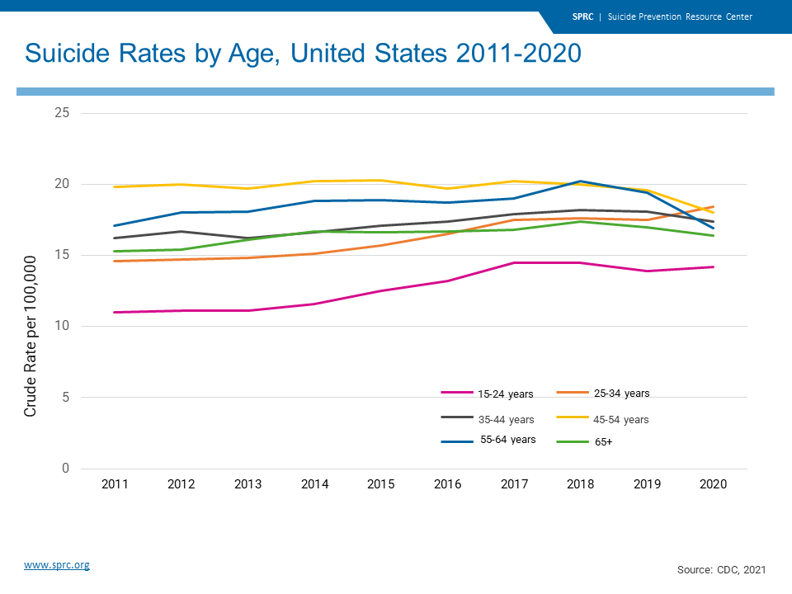
Equivalence Partitioning Test Case Design
A = program inputs
ages of people in a healthcare system database
R = in same age range as
Form equivalence classes of age groups
Use suicide rate from 2011-2022
Notes:
https://www.sprc.org/scope/age

Slide 58
Equivalence Partitioning Test Case Design
A = program inputs
ages of people in a healthcare system database
R = in same age range as
Form equivalence classes of age groups
Use suicide rate from 2011-2022
Design an app to help people at risk
Identify signs of suicidal ideation
Identify risk factors
Find age-appropriate resources

Slide 59
Equivalence Partitioning Test Case Design
A = program inputs
The questions asked and resources recommended depend on which equivalence class the person is in
Design an app to help people at risk
Identify signs of suicidal ideation
Identify risk factors
Find age-appropriate resources

Slide 60
Equivalence Partitioning Test Case Design
A = program inputs
The questions asked and resources recommended depend on which equivalence class the person is in
Design an app to help people at risk
Identify signs of suicidal ideation
Identify risk factors
Find age-appropriate resources

Slide 61
Equivalence Partitioning Test Case Design
A = program inputs
The questions asked and resources recommended depend on which equivalence class the person is in
You only need to write tests for one representative from each class
Design an app to help people at risk
Identify signs of suicidal ideation
Identify risk factors
Find age-appropriate resources

